Slide 1
JSON Database for Java Developers
Josh Spiegel

Slide 2
Overview
JSON Data Type
Java API for JSON in JDBC
JSON Collections
Java API for MongoDB

Slide 3
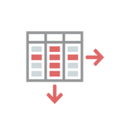

Converged Database
Multiple Data Models
Relational, document, graph, spatial, full-text...
Multiple Workloads
Transactional, operational, analytics, IoT, ML, AI...
One Database SQL, services, tooling, security, management, licensing...

Slide 4
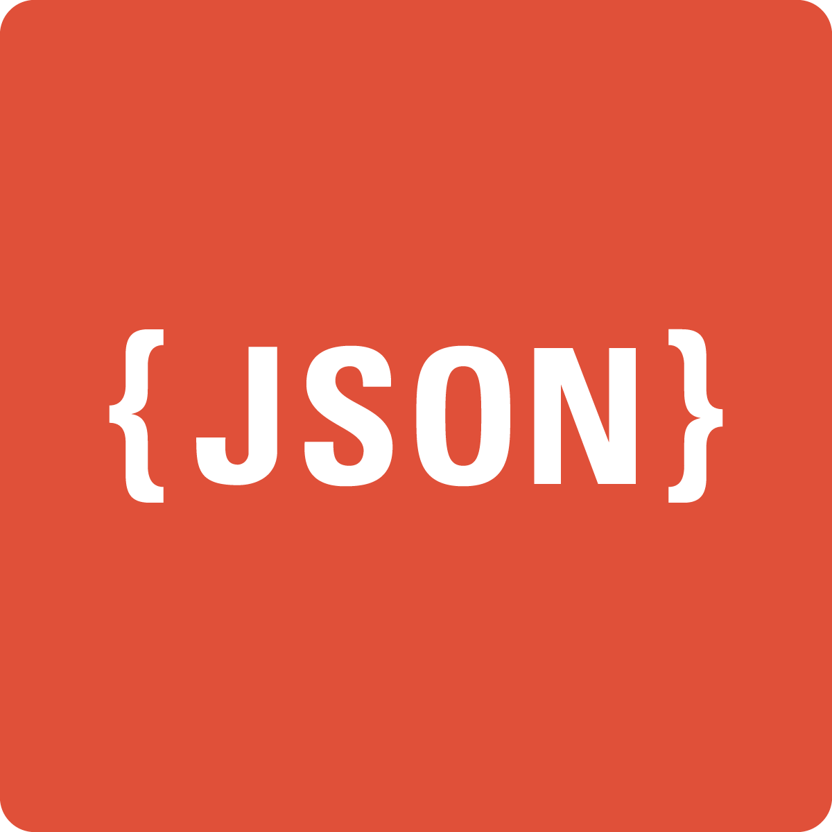
Autonomous JSON Database
Managed cloud version of the converged database
For JSON-centric development
Use MongoDB Collection APIs or SQL/JDBC
Managed / Autonomous Little to no database management required
Always-free option (20GB, 1 OCPU)
AJD

Slide 5

Autonomous JSON Database
Provides the same benefits as NoSQL document stores
24
$
7
Elastic compute and storage
Single-digit latency reads and writes
Highly available
Low price, always-free tier

Slide 6









Autonomous JSON Database
More than a NoSQL document store
Full ISO SQL 2016 support over JSON
ACID transactions with read-committed consistency
Advanced security
APEX low-code development
In-database result caching
In-database full-text search
SQL
REST

Slide 7
Overview
JSON Data Type
Java API for JSON in JDBC
JSON Collections
Java API for MongoDB

Slide 8
Why JSON?
Easily consumed by applications
Maps well to application (Java) objects
Nested structures
Read/write without joins
Schema-flexible
Applications can evolve to store new attributes without modifying data definitions.
Good exchange format
Supported by most programming languages
Human readable
{ "name" : "Thomas Anderson", "job" : "Programmer", "addresses" : [ { "street" : "123 Main", "city" : "Santa Cruz", "zip" : 95041 } ] }

Slide 9
JSON Data Type (21c+)
CREATE TABLE emp (data JSON);
Backed by binary JSON
Simplified SQL access
Extended types
Performance
INSERT INTO emp VALUES ( JSON { 'name' : 'Smith', 'job' : 'Agent' } );
SELECT t.data.name.string(), FROM emp t
WHERE t.data.job.string() = 'Agent';
Notes:
The Oracle Database 20c preview release introduces a new built-in SQL type for JSON data
The basic idea is that you can declare table columns as type json to store your json data
And then you can use SQL to read/write/query/and update your data in ways that are similar to how you would query more traditional relational data.
So in this grey box, for example, it create a table called emp, with a column of type json.
It inserts an employee json object into the table.
And then it does a simple select over that JSON data.
The server-side is now packed with useful features for working with JSON data but that isn't going to be the focus today. We had an ask tom on april 4th that was recorded that dives into more of these server side details.
But that isn't

Slide 10
SQL/JSON
Leverage full expressiveness of SQL over JSON data
Joins, aggregation, projection
Unnest nested JSON arrays
Construct new JSON values
Update nested values
JSON aggregation and construction
JSON unnesting
SELECT JSON { 'count' : count(*), 'dept' : e.jcol.dept.string() } FROM emps e WHERE e.jcol.title.string() = 'Engineer' GROUP BY e.jcol.dept.string() ORDER BY e.jcol.dept.string()
SELECT name, title, street FROM emps NESTED jcol COLUMNS ( name, title, NESTED address[*] columns ( street ) ) WHERE name = 'Anderson'

Slide 11
JSON Extended Types
Standard
OBJECT { }
ARRAY [ ]
STRING
TRUE/FALSE
NULL
NUMBER
Extended
BINARY_FLOAT
BINARY_DOUBLE
TIMESTAMP/DATE
INTERVALDS/INTERVALYM
RAW
Fidelity with relational data
CREATE TABLE orders VALUES ( oid NUMBER,
created TIMESTAMP, status VARCHAR2(10), );
SELECT JSON {*} FROM orders;
{ "oid":123, "created":"2020-06-04T12:24:29Z", "status":"OPEN" }

Slide 12
Binary JSON performance
JSON type values are stored and transmitted as Oracle's binary JSON format (OSON)
Internal indexes to support efficient random access to object and arrays
Self-contained, schema flexible
Object keys encoded in a self-contained header dictionary
Ingestion/retrieval
Documents compress due to dictionary encoding, reducing IO and transfer costs
Both servers and clients can avoid text serialization and parsing
In-place access possible for low-latency, low-memory access
No need to copy data to other intermediate data structures (e.g. hash tables, arrays)
Query
Query evaluation doesn’t require text parsing, can navigate directly to nested values
Path evaluation without using string comparisons on keys
Update – supports fine-grained updates without replacing the whole document
See VLDB 2020: Native JSON Datatype Support: Maturing SQL and NoSQL convergence in Oracle Database

Slide 13
Efficient Random Access
{"name":"Smith","job":"Programmer","salary":40000}
SQL
Java
e.data.name.string()
obj.getString("name")
OSON
OSON
Dictionary
salary=0, job=1, name=2
Dictionary
salary=0, job=1, name=2
Jumps Offsets
[0->22,1->0,2->18]
Jumps Offsets
[0->22,1->0,2->18]
Values
Programmer,Smith,4000
Values
Programmer,Smith,4000
Database
Network
Application

Slide 14

History
Binary JSON (OSON)
Extended SQL types
Performance
12g (2016)
18c
19c
21c
JSON-text storage and query processing (clob, blob, varchar2)
Binary JSON Storage (only collections in Autonomous Databases)
JSON data type and collections backed by Binary JSON storage

Slide 15
Overview
JSON Data Type
Java API for JSON in JDBC
JSON Collections
Java API for MongoDB

Slide 16
The Java API for JSON in JDBC (21c+)
Facilities to read, write, and modify JSON type values from Java
Features
Mutable tree/object model
Event-based parser and generator
Access to extended SQL/JSON types (TIMESTAMP, DATE, etc.)
Supports both JSON text and OSON
Optional integration with JSON-P / JSR-374
Where is it?
JAR: ojdbc8.jar or ojdbc11.jar
OTN
Maven Central Repository (groupId = com.oracle.database.jdbc, artifactId = ojdbc8)
Package: oracle.sql.json

Slide 17



Package: oracle.sql.json
Description | Classes/interfaces
Tree model | OracleJsonObject OracleJsonArray OracleJsonString OracleJsonDecimal OracleJsonDouble OracleJsonTimestamp OracleJsonBinary OracleJsonIntervalDS OracleJsonIntervalYM ...
Event model | OracleJsonParser OracleJsonGenerator
Factory | OracleJsonFactory

Slide 18
Class: OracleJsonFactory
Description | Methods
Read/write OSON | createJsonBinaryGenerator(OutputStream) createJsonBinaryValue(ByteBuffer) createJsonBinaryValue(InputStream) createJsonBinaryParser(ByteBuffer) createJsonBinaryParser(InputStream)
Read/write JSON text | createJsonTextGenerator(OutputStream) createJsonTextGenerator(Writer) createJsonTextValue(InputStream) createJsonTextValue(Reader) createJsonTextParser(InputStream) createJsonTextParser(Reader)
In-memory, mutable, tree model creation | createObject(), createObject(OracleJsonObject) createArray(), createArray(OracleJsonArray) createString(String) createDecimal(BigDecimal), createDecimal(int), createDecimal(long) createDouble(double) createTimestamp(Instant) ....

Slide 19
Tree Model
{
"name" : "Smith",
"created" : "2019-01-21T21:25:05.610718", "phone" : ["314-555-5555","650-555-5555"] }
object {}
get("name")
get("phone")
get("created")
Smith
2019-01-21T21:25:05.610718
array []
get(0)
get(1)
314-555-5555
650-555-5555

Slide 20
Example – Creating a value
OracleJsonFactory factory = new OracleJsonFactory();
OracleJsonObject emp = factory.createObject();
emp.put("name", "Smith");
emp.put("salary", 40000);
emp.put("created", Instant.now());
System.out.println(emp.get("name"));
System.out.println(emp.toString());
Smith {"name":"Smith","salary":40000,"created":"2019-01-21T21:25:05.610718"}

Slide 21
Tree Model Interfaces
OracleJsonValue
Interface | Enum | SQL | JSON
OracleJsonObject | OBJECT |  | { }
OracleJsonArray | ARRAY |  | [ ]
OracleJsonDecimal | DECIMAL | NUMBER | Number
OracleJsonDouble | DOUBLE | BINARY_DOUBLE
OracleJsonFloat | FLOAT | BINARY_FLOAT
OracleJsonString | STRING | VARCHAR2 | String
OracleJsonBinary | BINARY | RAW
OracleJsonTimestamp | TIMESTAMP | TIMESTAMP
OracleJsonTimestampTZ | TIMESTAMPTZ | TIMETAMP WITH TIMEZONE
OracleJsonDate | DATE | DATE
OracleJsonIntervalDS | INTERVALDS | INERVAL DAY TO SECOND
OracleJsonIntervalYM | INTERVALYM | INTERVAL YEAR TO MONTH

Slide 22
Tree Model – Type Hierarchy
OracleJsonIntervalYM
OracleJsonValue
OracleJsonIntervalDS
OracleJsonDate
OracleJsonTimestamp
java.util.Map
OracleJsonStructure
java.util.List
OracleJsonTimestampTZ
OracleJsonBinary
OracleJsonObject
OracleJsonArray
OracleJsonNumber
OracleJsonString
OracleJsonDecimal
OracleJsonDouble
OracleJsonFloat

Slide 23
Tree Model Sources
OracleJsonObject and OracleJsonArray support updates when not directly created from OSON.
Description | Source | Read-only?
From the database | ResultSet.getObject() | Yes
Created from OSON | createJsonBinaryValue(ByteBuffer) createJsonBinaryValue(InputStream) | Yes
Created from JSON text | createJsonTextValue(Reader) createJsonTextValue(InputStream) | No
Created programmatically | createObject() createArray() | No
Copied | createObject(OracleJsonObject) createArray(OracleJsonArray) | No

Slide 24
Event model
{
"name" : "Smith",
"created" : "2019-01-21T21:25:05.610718", "phone" : ["314-555-5555","650-555-5555"] }
{
Key: name
Smith
Key: created
2019-01-21T...
Key: phone
[
650-55...
OracleJsonParser
Produces a sequence of events
parser.next()
Events can come from text or OSON
OracleJsonGenerator
Consumes a sequence of events
generator.write(...)
Generates text or OSON

Slide 25
OracleJsonGenerator
OracleJsonFactory factory = new OracleJsonFactory();
FileOutputStream out = new FileOutputStream("emp.oson");
OracleJsonGenerator generator = factory.createJsonBinaryGenerator(out);
generator.writeStartObject();
generator.write("name", "smith");
generator.write("salary", 40000);
generator.write("created", Instant.now());
generator.writeEnd();
generator.close();

Slide 26
OracleJsonParser
FileInputStream in = new FileInputStream("emp.oson");
OracleJsonParser parser = factory.createJsonBinaryParser(in);
while (parser.hasNext()) {
switch (parser.next()) {
case START_OBJECT:
System.out.println("Start object.");
break;
case END_OBJECT:
System.out.println("End object.");
break;
case KEY_NAME:
System.out.println("Key: " + parser.getString());
break;
case VALUE_DECIMAL:
System.out.println("Number: " + parser.getInt());
break;
case VALUE_STRING:
System.out.println("String: " + parser.getString());
break;
case VALUE_TIMESTAMP:
System.out.println("Timestamp: " + parser.getInstant());
break;
}
}
Start object.
Key: name
String: smith
Key: salary
Number: 40000
Key: created
Timestamp: 2019-01-21T21:53:39.833976Z
End object.

Slide 27
SQL Integration
SQL statements can consume and and produce JSON values
Relies on standard getObject() and setObject() methods throughout JDBC

Slide 28
Getting JSON from the database
SQL Methods that return JSON
java.sql.ResultSet .getObject(*, Class<T>) java.sql.CallableStatement .getObject(*, Class<T>)
Class | Content
java.lang.String, java.io.Reader java.io.InputStream | JSON text
oracle.sql.json.OracleJsonValue jakarta.json.JsonValue | Tree Model
oracle.sql.json.OracleJsonParser jakarta.json.stream.JsonParser | Event Model
oracle.sql.json.OracleJsonDatum | Raw OSON
ResultSet rs = stmt.executeQuery("SELECT data FROM emp");
rs.next();
OracleJsonObject smith = rs.getObject(1, OracleJsonObject.class);

Slide 29
Sending JSON to the database
SQL methods accept JSON
java.sql.PreparedStatement .setObject(*, Object, SQLType) java.sql.ResultSet .updateObject(*, Object, SQLType) java.sql.CallableStatement .setObject(*, Object, SQLType) java.sql.RowSet .setObject(*, Object, SQLType)
Class | Content
java.lang.CharSequence, java.lang.String java.io.Reader | JSON text
java.io.InputStream, byte[] | UTF8 or OSON
oracle.sql.json.OracleJsonValue jakarta.json.JsonValue | Tree Model
oracle.sql.json.OracleJsonParser jakarta.json.stream.JsonParser | Event Model
oracle.sql.json.OracleJsonDatum | Raw OSON
OracleJsonObject emp = ...; PreparedStatement pstmt = con.prepareStatement("INSERT INTO emp VALUES (:1)");
pstmt.setObject(1, emp, OracleType.JSON);

Slide 30
JSR-374 JSON-P
JSON-P (JSON Processing) is a Java API to parse and generate JSON
oracle.sql.json can loosely be thought of as an extension of JSON-P
JSON-P 1.0 -> javax.json
JSON-P 2.0 -> jakarta.json
Has tree model and event model
Differences from oracle.sql.json:
supports extended types
supports a mutable tree model
supports conversion to and from OSON
does not support builders/reader or the services API

Slide 31
JSON-P: Wrap and Unwrap
wrap()
oracle.sql.json | jakarta.json
OracleJsonObject | JsonObject
OracleJsonArray | JsonArray
OracleJsonDecimal | JsonNumber
OracleJsonDouble
OracleJsonFloat
OracleJsonString | JsonString
OracleJsonBinary
OracleJsonTimestamp
OracleJsonDate
OracleJsonIntervalDS
OracleJsonIntervalYM
OracleJsonGenerator | JsonGenerator
OracleJsonParser | JsonParser
Interfaces are different views of the same data
Wrap and unwrap do not make a deep copy or incur a performance penalty (e.g. in-place supported for javax.json)
javax.json instances produced by JDCB implement java.sql.Wrapper
Wrapper.unwrap()

Slide 32
When to use JSON-P?
Your application already implements jakarta.json interfaces and you want the database to consume them
Your application uses a third-party library that implements jakarta.json and you need the database to consume them
You want to keep your application independent of Oracle Database specific APIs and extended types
You want to use JSON-B
ResultSet rs = stmt.executeQuery("SELECT data FROM emp ");
rs.next();
JsonObject smith = rs.getObject(1, jakarta.json.JsonObject.class);

Slide 33
JSR-367 JSON-B
JSON-B (JSON Binding) convert Java objects to/from JSON
Default mapping between any Java object and JSON
Java Annotations to customize default mapping if necessary
Yasson is the default implementation of JSON-B
Use Yasson and JDBC to persist Java objects as binary JSON without parsing/serializing JSON text
Provides efficient ingest, retrieve, and query of application domain objects
Complex objects with nested relationships can be retrieved without joins
Java Object
Binary JSON (OSON)
Database
class Employee {
String name;
String job;
}
{ name: ... job: ... }
100101000010100101010100101010100101

Slide 34
Demo Java API for JSON in JDBC
https://github.com/oracle/json-in-db/tree/master/JdbcExamples

Slide 35
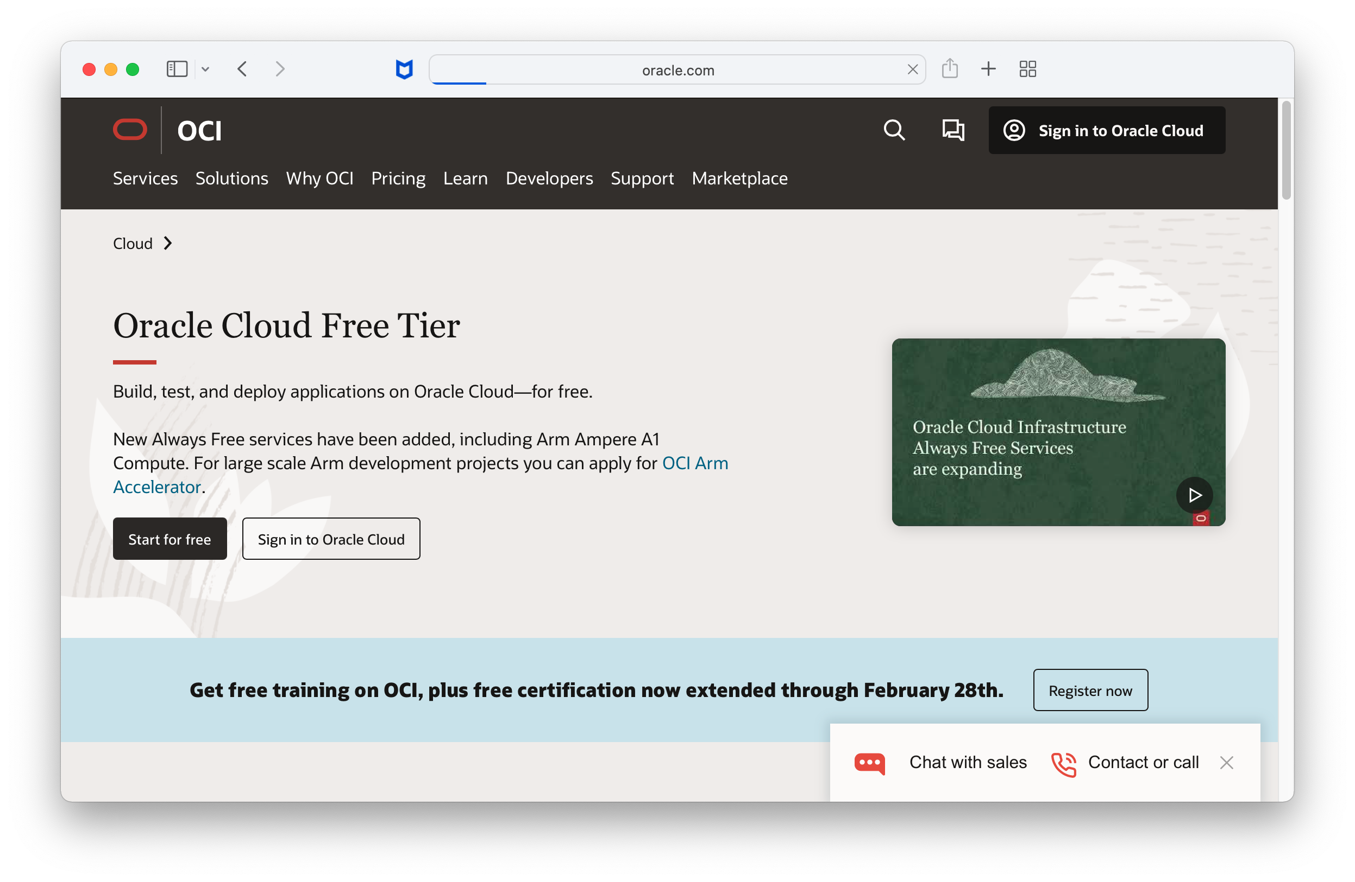
https://www.oracle.com/cloud/free/

Slide 36
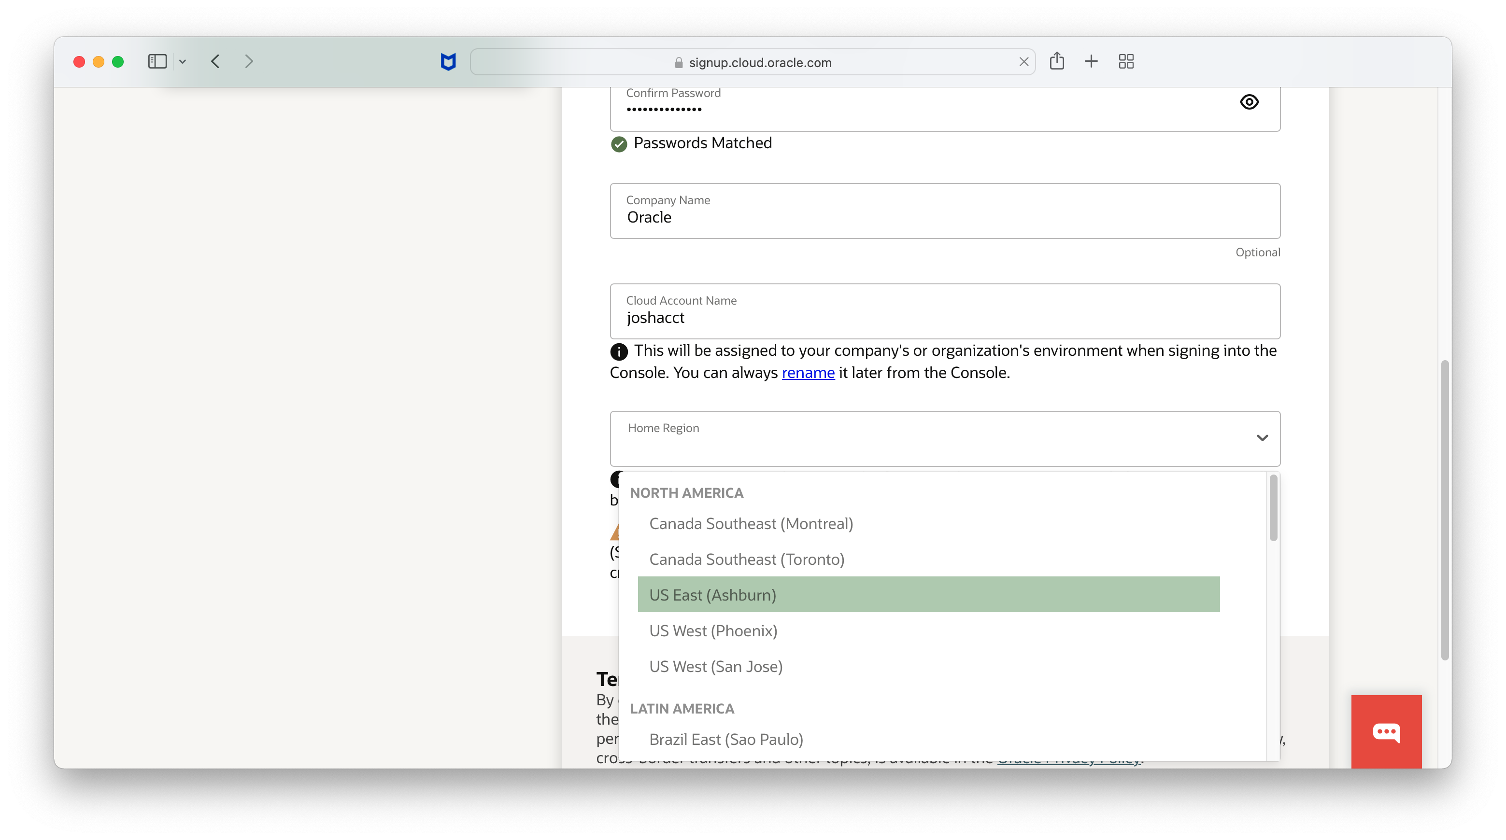
If possible, pick Ashburn, Phoenix, Frankfurt, or London as it will give you access to 21c

Slide 37
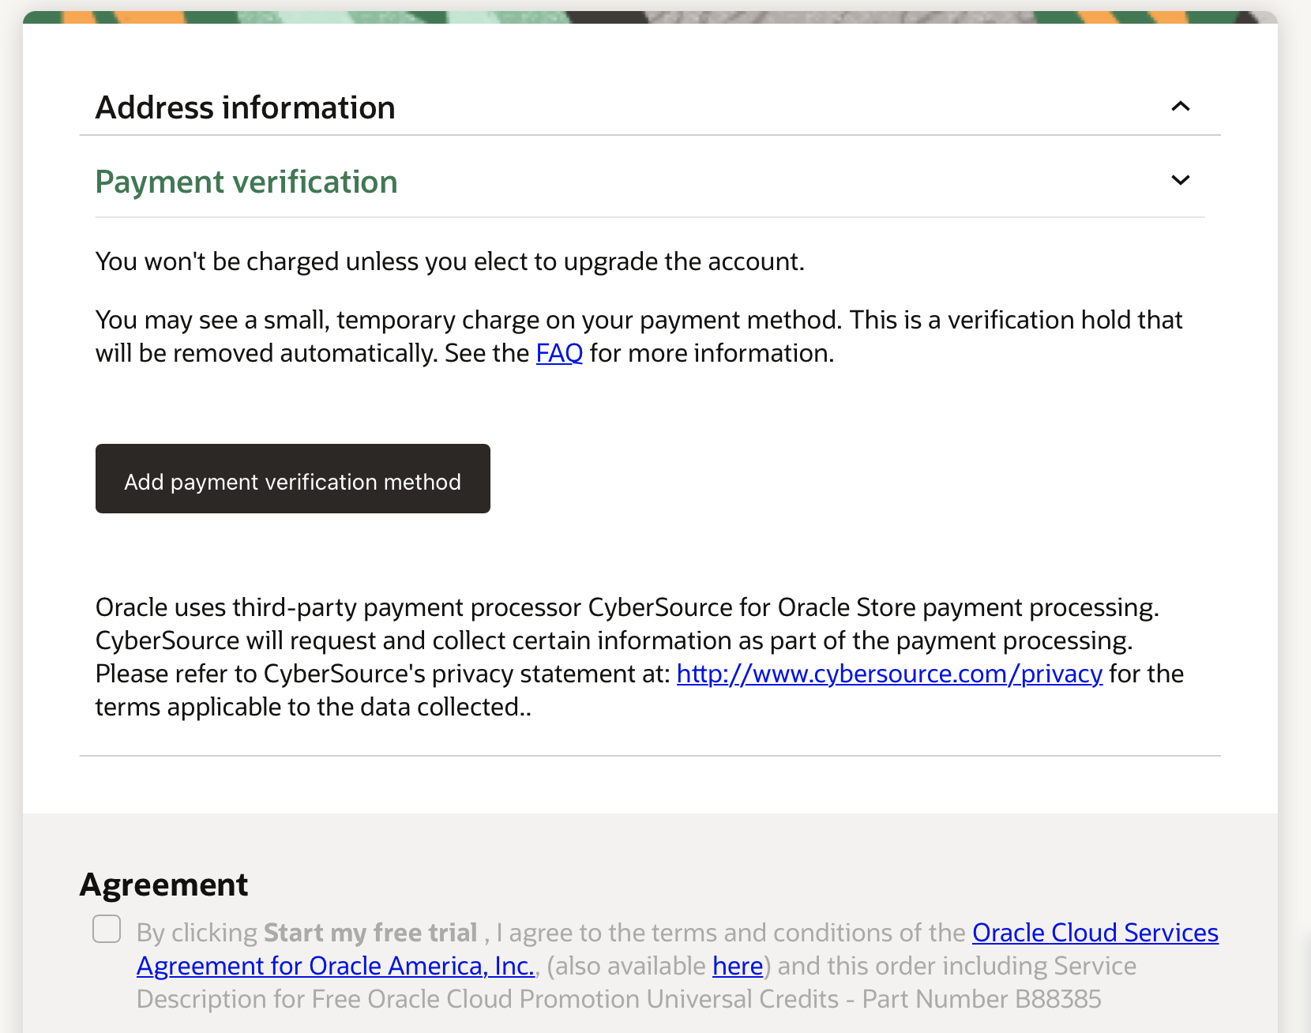
This is just to verify your identity. It won't charge you unless you explicitly decide to upgrade to a paid account.

Slide 38
Overview
JSON Data Type
Java API for JSON in JDBC
JSON Collections
Java API for MongoDB

Slide 39

Converged Database – JSON Use Cases
Relational to JSON
For exposing data to services
Flexfields
Table with a flexible schema
JSON Analytics & Reports
Dataguide for schema discovery
JSON Payload
Avoid some normalization
Pure JSON
NoSQL Document Store

Slide 40
Converged Database – JSON Use Cases
Relational to JSON
For exposing data to services
Flexfields
Table with a flexible schema
JSON Analytics & Reports
Dataguide for schema discovery
JSON Payload
Avoid some normalization
Pure JSON
NoSQL Document Store

Slide 41










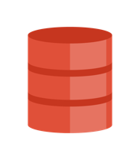
Oracle JSON Collections
The benefits of SQL and NoSQL
Collections APIs Build microservices and applications using NoSQL style CRUD APIs
SQL for JSON All the benefits of the converged database like SQL and analytics directly over JSON collections.
Notes:
As you pursue the ROI/TCO case for the converged database, I encourage you to keep a few things in mind:
1. The argument for the converged database is "get your single-purpose database features without the single-purpose tax.".
The converged database story can easily be misunderstood as “set up one big database and put everything in it.” This will rightly be rejected by developers and CTOs alike because it’s so far out of step with the spirit of internet-age architectures which is “many pieces, loosely joined.” Instead, the essence of the converged database story is “one engine with many faces.” Companies should use multiple instances of the converged database, each configured to the data model and workload required, instead of multiple single-purpose database products, each with its own architecture, tooling, security methods, patching schedules, and upgrade paths. Every time you need a database of some sort—document, graph, relational—for some job—IoT, data warehouse, mobile app, payment processing—you should use a configuration of the same core engine tailored to that use case. In addition, you can also run different kinds of workloads on that same dataset should you desire. This way, developers, data scientists, analysts get what they want—a database that helps them build the specific project they’re working on—and CTOs get what they want—easier repurposing of data across the enterprise and simpler operations to sustain this.
2. The converged database argument must deliver different but complimentary messages to two distinct audiences.
The lion’s share of benefits from the converged database accrue to CTOs, enterprise architects, and data ops people. These are the folks whose lives become easier if they’re overseeing a fleet of the same core engine in different configurations rather than a menagerie of diverse database products. Developers, by the nature of their work and skills, are more interested in the app or AI they’re building than the database it relies on. They don’t really want to know much about the database their work relies on. By this measure, the one they have to know the least about is the one they like best. So, the core of the converged database message for each developer is “Don’t worry. You’ll have an API that looks and functions just like any other document database (or graph database, etc).
3. The converged database story contains an implicit argument about increasing data value.
If you can write your data to a converged database as, say, JSON, and then an analyst can query it with SQL for analytical dashboards, and data scientists can query it with PGQL for graph analysis of linkages across the JSON docs, then the company can more easily use that single dataset in more ways. Using data in more ways means that a single dataset can serve more points of use, thereby creating more value. While this can be done with a constellation of single-purpose databases, reducing the time, effort, and risk to do so increases the likelihood of this incremental data usage while reducing the cost to do so.

Slide 42
JSON Collections
Employees
ID | NAME | TITLE
1 | Smith | Agent
2 | Anderson | Programmer
A document is a JSON value
Document is identified by a key
Key drives CRUD operations: get, update, delete
Support of filter queries
Store documents inside a collection
Collection stores similar documents
Collection is identified by name
One or more collections reside in a database
Application connects to database
Employees
{ "_id" : 1, "name": "Smith", "title": "Agent" }
{ "_id" : 1, "name": "Smith", "title": "Agent" }

Slide 43

JSON Collections
row
A document is a JSON value
Document is identified by a key
Key drives CRUD operations: get, update, delete
Support of filter queries
Store documents inside a collection
Collection stores similar documents
Collection is identified by name
One or more collections reside in a database
Application connects to database
table
ID | DATA
1 | {"name": "Smith", "title": "Agent" }
2 | {"name": "Anderson", "title": "Agent" }
schema

Slide 44
Collections are a "view" over a table
Collections API | Pseudo Translation
Collection db.createCollection('emp') | Table create table emp (data json)
Document db.emp.insert({"name":"Miller"}) | Document insert into emp values(json {'name':'Miller'})
Filter db.emp.find({"job":"Agent"}) | Query select * from emp e where e.data.job = 'Agent'

Slide 45
Overview
JSON Data Type
Java API for JSON in JDBC
JSON Collections
Java API for MongoDB

Slide 46
Accessing Collections From Java
Java API for MongoDB
SODA Java API
MongoClient mongoClient = MongoClients.create(connString);
MongoDatabase database = mongoClient.getDatabase("finance");
MongoCollection<Document> coll = database.getCollection("pos");
Document po = Document.parse(json);
coll.insertOne(po);
Bson filter = eq("Requestor", "Alexis Bull");
MongoCursor<Document> cursor = coll.find(filter).cursor();
Document doc = cursor.next();
OracleClient sodaClient = new OracleRDBMSClient();
OracleDatabase database = sodaClient.getDatabase(jdbcConn);
OracleCollection coll = database.openCollection("pos");
OracleDocument po = database.createDocumentFromString(json);
coll.insert(po);
OracleCursor cursor = coll.find().filter("""
{"Requestor": "Alexis Bull"}""").getCursor();
OracleDocument doc = cursor.next();
Option 1: Use MongoDB's Java driver to connect to Oracle Database (Autonomous Database 19c+)
Option 2: Use SODA Java - a wrapper around JDBC (All Databases, 12g+)
Notes:
Updated with:
MongoDB 4.1.0 Java API
SODA for Java 1.1.4 API
JDK 14 Text blocks
Only sodaClient is thread safe, in order to get good performance, you have to (1) manually use UCP (2) turn on statement caching (3) turn on SODA metadata caching

Slide 47
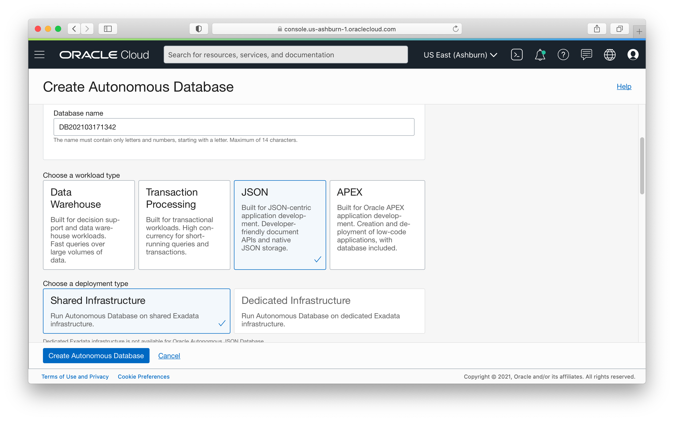
Oracle API for MongoDB
Only supported for Autonomous Transaction Processing (ATP) and JSON (AJD)

Slide 48
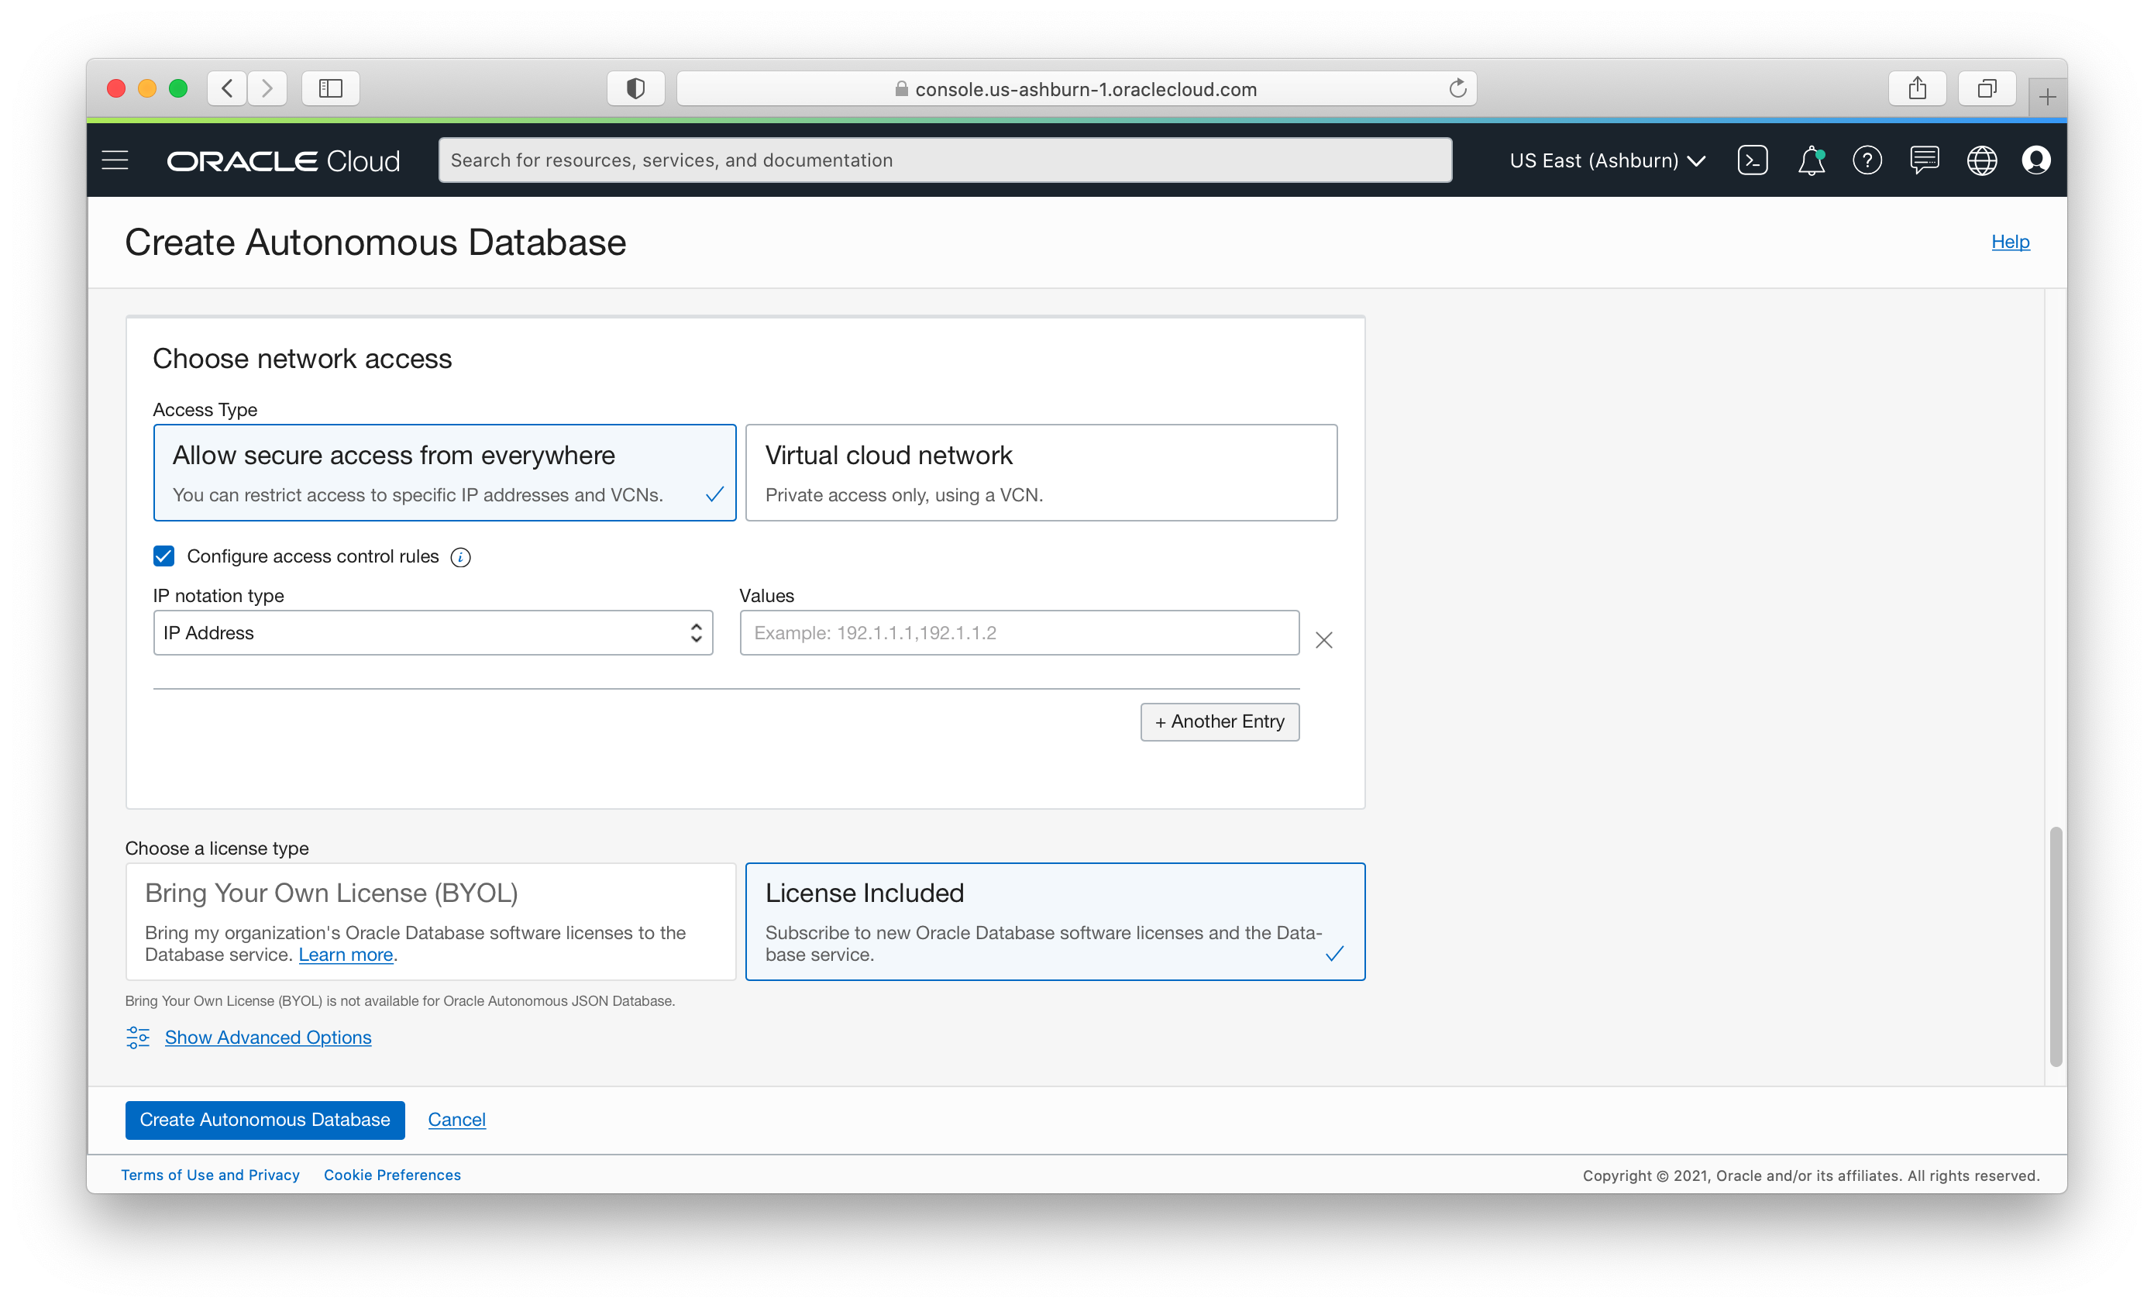
Oracle API for MongoDB
ACLs are required to access the Mongo API.

Slide 49
Connection String
database credentials - user must have SODA_APP role
mongodb://admin:Tiger123!@
g0a51db2590de87-demo.adb-dev.eu-frankfurt-1.oraclecloudapps.com:27017/ admin?authMechanism=PLAIN&authSource=$external&ssl=true &loadBalanced=true&retryWrites=false
hostname identifies your database
Mongo database == Oracle schema
TLS/SSL required

Slide 50
Demo Oracle API for MongoDB
https://github.com/oracle/json-in-db/tree/master/MongoExamples

Slide 51
References
Oracle Autonomous JSON Database http://www.oracle.com/autonomous-database/autonomous-json-database/
Get Started with Oracle Autonomous JSON Database for free https://www.oracle.com/autonomous-database/autonomous-json-database/get-started/
Java API for JSON type examples https://github.com/oracle/json-in-db/tree/master/JdbcExamples
Oracle API for MongoDB examples https://github.com/oracle/json-in-db/tree/master/MongoExamples

